Slide 1

Tulpics
Contoso
September 28, 2023
ALFA Team
Notes:
Line spacing + Page numbers

Slide 2
Project idea
The project aims to develop a comprehensive mobile application and web platform that provides personalized guidance for plant care and disease management. The application leverages artificial intelligence and machine learning technologies to offer tailored recommendations for planting, watering, and harvesting based on the specific type of plant, local environmental conditions, and seasonal factors. Users will be able to easily identify plant diseases through image scanning, receive real-time alerts for optimal care actions, and access informative content about each plant's requirements. The platform will cater to farmers, garden enthusiasts, researchers, and anyone interested in cultivating healthy plants. By merging technology with agriculture, the project seeks to empower users with knowledge, optimize plant growth, and minimize crop damage caused by diseases, ultimately contributing to sustainable farming practices and environmental awareness.

Slide 3
Abstract
The "Tulpics" project aims to revolutionize plant care and disease management through an innovative mobile application and web platform. By harnessing the power of artificial intelligence and machine learning, Tulpics offers personalized guidance for planting, watering, and harvesting, tailored to the unique characteristics of each plant species, local environmental conditions, and seasonal fluctuations. This technology empowers farmers, garden enthusiasts, researchers, and plant lovers to cultivate thriving plants and combat diseases effectively. Tulpics also fosters a global community of seed enthusiasts and agricultural engineers, facilitating knowledge-sharing and collaboration for sustainable farming practices and heightened environmental awareness.

Slide 4
Main features
Personalized Plant Care Recommendations:
AI-driven insights provide customized suggestions for planting, watering, and harvesting, optimizing plant growth based on plant type, local climate, and seasonal factors..
2.Disease Detection and Management:
Image scanning technology enables users to identify plant diseases promptly, allowing for timely intervention and prevention.
3.Real-time Care Alerts:
Users receive real-time notifications and alerts for optimal care actions, ensuring that plants receive the attention they need at the right time.
4.Comprehensive Plant Database:
A vast plant database contains detailed information about a wide range of plant species, including care requirements, growth habits, and disease vulnerabilities.

Slide 5
Main features
5.Informative Plant Content:
Users can access informative content about each plant's requirements, enabling them to make informed decisions about cultivation and care.
6.Global Community and Collaboration:
A web platform connects seed enthusiasts, farmers, and agricultural engineers from around the world, facilitating knowledge exchange, networking, and collaboration.
7.Expert Guidance and Support:
Agricultural experts and enthusiasts contribute their insights and expertise, offering guidance and solutions to specific plant care challenges.
8.Educational Resources:
The platform provides educational resources, articles, and guides to enhance users' understanding of plant care, disease management, and sustainable farming practices.

Slide 6
Main features
9.User-Generated Content:
Users can share their experiences, success stories, and challenges, creating a vibrant community that learns and grows together.
10.Sustainable Farming Impact:
Tulpics promotes sustainable farming practices by equipping users with knowledge and tools to minimize crop damage caused by diseases, leading to improved yield and reduced environmental impact.
11.Environmental Awareness:
By fostering a community that values plant care and the environment, Tulpics contributes to greater environmental awareness and conservation efforts.
12.Interactive Plant Identification:
A feature for identifying plants through photos aids users in learning about new species and their care needs.

Slide 7
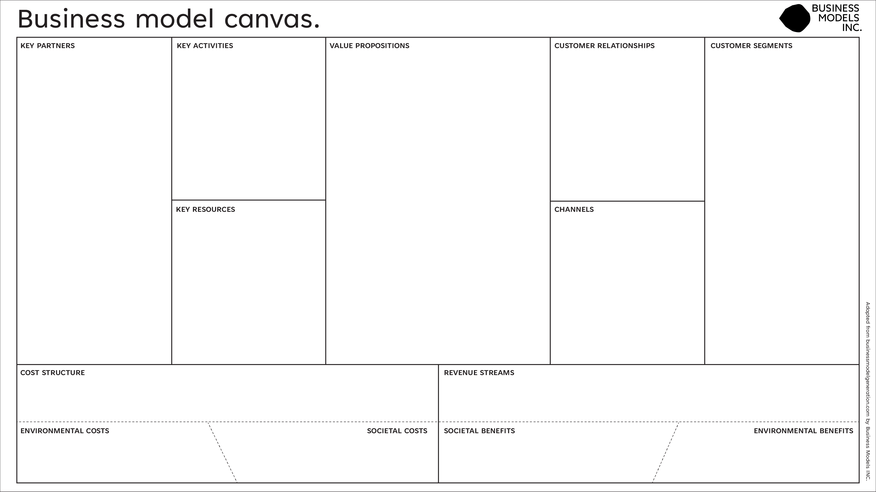
AI Algorithm Development
Plant Database Management
Content Creation and Curation
User Engagement and Support
App and Platform Maintenance
Personalized Plant Care Recommendations
Disease Detection and Management
Real-time Care Alerts
Comprehensive Plant Database
Informative Plant Content
Global Community and Collaboration
Expert Guidance and Support
Educational Resources
Sustainable Farming Impact
Environmental Awareness
AI-Driven Personalization
Community Engagement
Customer Support and Q&A
Expert Contributions
Farmers
Garden Enthusiasts
Researchers
Agricultural Engineers
Plant Lovers
Agricultural Research Institutions
Plant Nurseries and Suppliers
Agricultural Equipment Manufacturers
Environmental Conservation Organizations
AI and Machine Learning Technology
Plant Database and Content
Development Team
Agricultural Experts and Contributors
Server Infrastructure
Mobile Application (iOS, Android)
Web Platform
Social Media (for community engagement)
Partnerships with Agricultural Organizations
Development and Maintenance Costs
Content Creation and Curation Expenses .Server and Infrastructure Costs
Marketing and Promotion Expenses .Customer Support Costs

